Slide 1
Tutorial 12
ADVD
Neeraj Mishra

Slide 2
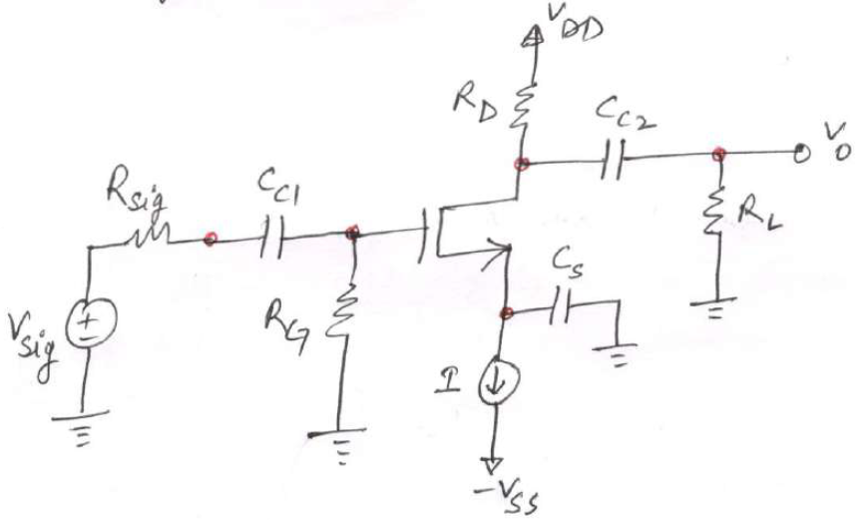

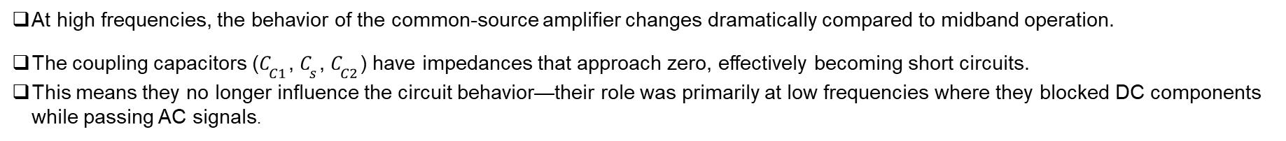
PROBLEM 1:
COMMON SOURCE AMPLIFIER - HIGH FREQUENCY ANALYSIS
Problem Overview
Circuit: Common-source MOSFET amplifier with single stage
Goal: Find midband gain (A_{m}) and upper 3-dB frequency (f_{H})
Given Parameters
Signal source resistance: $R_{sig}=100 \text{k}Ω$
Gate resistance: $R_{G}=4.7 \text{M}Ω$
Drain and load resistances: $R_{D}=R_{L}=15 \text{k}Ω$
Transconductance: $g_{m}=1 \text{mA}\text{/}\text{V}$
Output resistance: $r_{o}=150 \text{k}Ω$
Gate-source capacitance: $C_{gs}=1 \text{pF}$
Gate-drain capacitance: $C_{gd}=0.4 \text{pF}$
At high frequencies, the behavior of the common-source amplifier changes dramatically compared to midband operation.
The coupling capacitors ($C_{C1}$, $C_{s}$, $C_{C2}$) have impedances that approach zero, effectively becoming short circuits.
This means they no longer influence the circuit behavior—their role was primarily at low frequencies where they blocked DC components while passing AC signals.

Slide 3
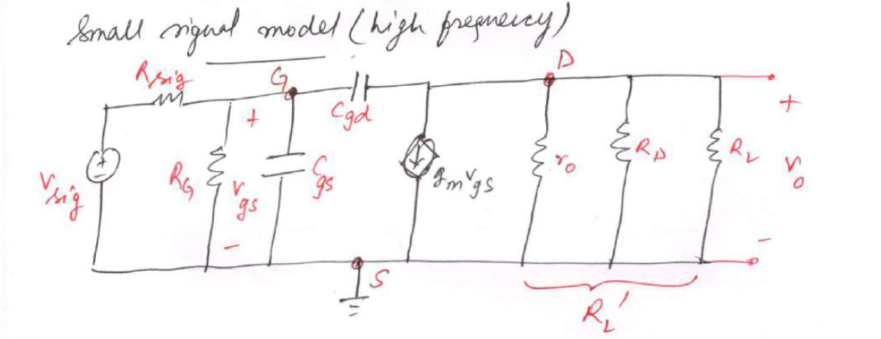
STEP 1: Identify High-Frequency Effect
Key Points: - At high frequencies, coupling capacitors C_{C1}, C_{s}, C_{C2} → short circuit (negligible) - Parasitic device capacitances C_{gs} and C_{gd} become dominant - C_{gd} creates feedback path between input and output → MILLER EFFECT
Physical Intuition: - Small feedback capacitance appears much larger due to voltage amplification - This limits high-frequency gain and bandwidth

Slide 4
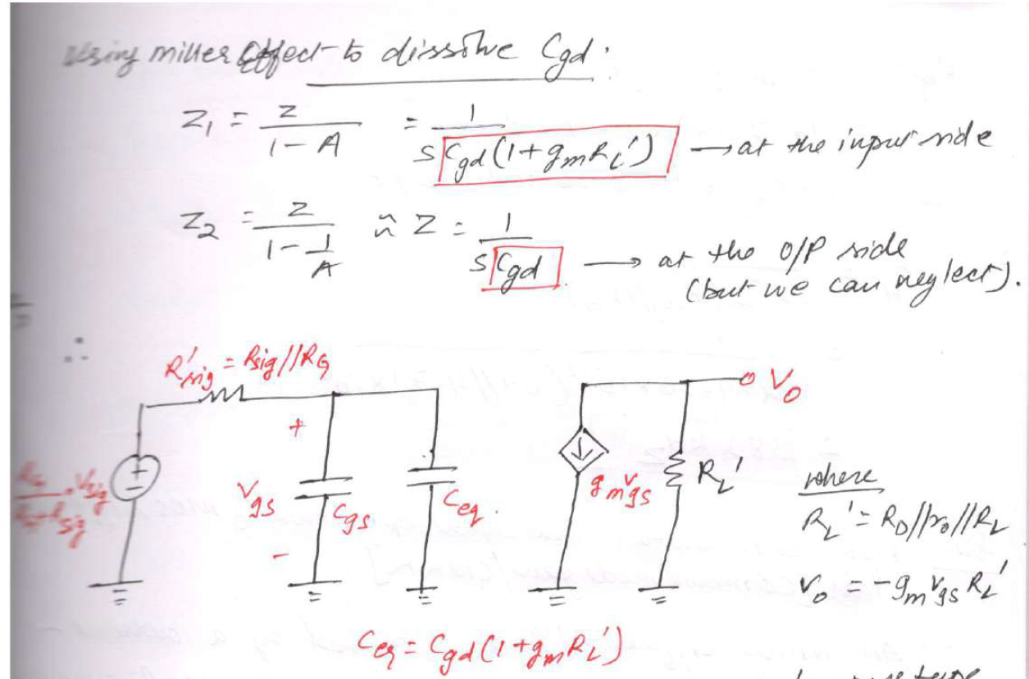
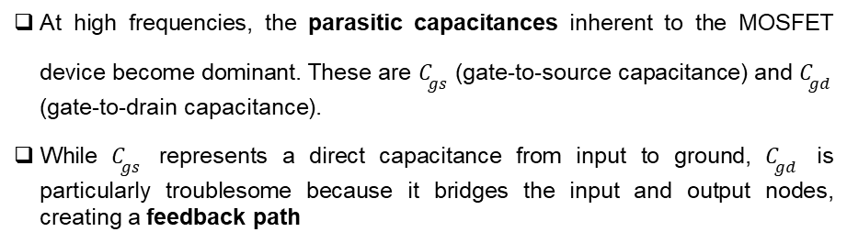
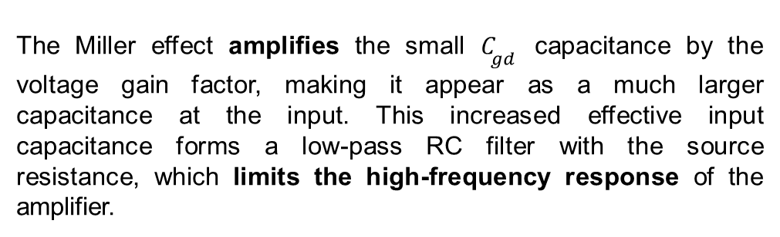
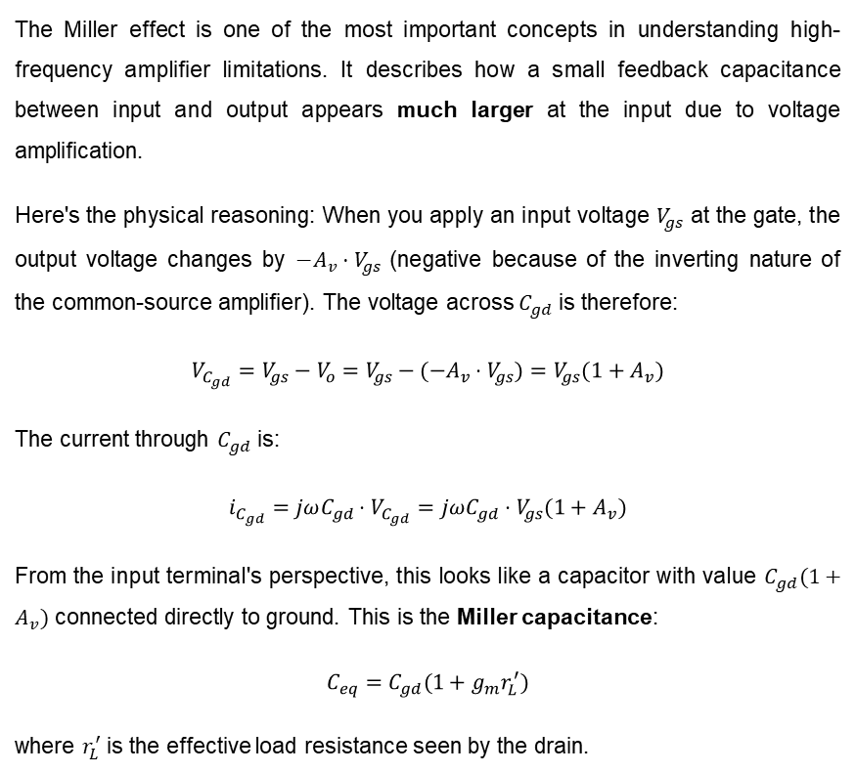
At high frequencies, the parasitic capacitances inherent to the MOSFET device become dominant. These are $C_{gs}$ (gate-to-source capacitance) and $C_{gd}$ (gate-to-drain capacitance).
While $C_{gs}$ represents a direct capacitance from input to ground, $C_{gd}$ is particularly troublesome because it bridges the input and output nodes, creating a feedback path
The Miller effect is one of the most important concepts in understanding high-frequency amplifier limitations. It describes how a small feedback capacitance between input and output appears much larger at the input due to voltage amplification.
Here's the physical reasoning: When you apply an input voltage $V_{gs}$ at the gate, the output voltage changes by $−A_{v}⋅V_{gs}$ (negative because of the inverting nature of the common-source amplifier). The voltage across $C_{gd}$ is therefore:
$$V_{C_{gd}}=V_{gs}−V_{o}=V_{gs}−(−A_{v}⋅V_{gs})=V_{gs}(1+A_{v})$$
The current through $C_{gd}$ is:
$$i_{C_{gd}}=jωC_{gd}⋅V_{C_{gd}}=jωC_{gd}⋅V_{gs}(1+A_{v})$$
From the input terminal's perspective, this looks like a capacitor with value $C_{gd}(1+A_{v})$ connected directly to ground. This is the Miller capacitance:
$$C_{eq}=C_{gd}(1+g_{m}r_{L}^{′})$$
where $r_{L}^{′}$ is the effective load resistance seen by the drain.
The Miller effect amplifies the small $C_{gd}$ capacitance by the voltage gain factor, making it appear as a much larger capacitance at the input. This increased effective input capacitance forms a low-pass RC filter with the source resistance, which limits the high-frequency response of the amplifier.

Slide 5

STEP 2: Calculate Effective Load Resistance
The drain of the MOSFET sees three resistances in parallel: the MOSFET's output resistance $r_{o}$, the drain resistor $R_{D}$, and the load resistor $R_{L}$:
Formula:
$R_{L}^{′}=r_{o}∥R_{D}∥R_{L}$
Calculation:
$R_{L}^{′}=\frac{1}{\frac{1}{r_{o}}+\frac{1}{R_{D}}+\frac{1}{R_{L}}}$
$R_{L}^{′}=\frac{1}{\frac{1}{150k}+\frac{1}{15k}+\frac{1}{15k}}$
$R_{L}^{′}=\frac{1}{0.00667+0.0667+0.0667}=\frac{1}{0.1400}=7.14$ kΩ
Result: $R_{L}^{′}$= 7.14 kΩ
Meaning: - Represents actual AC load impedance seen by drain - Three resistances in parallel reduce effective load

Slide 6
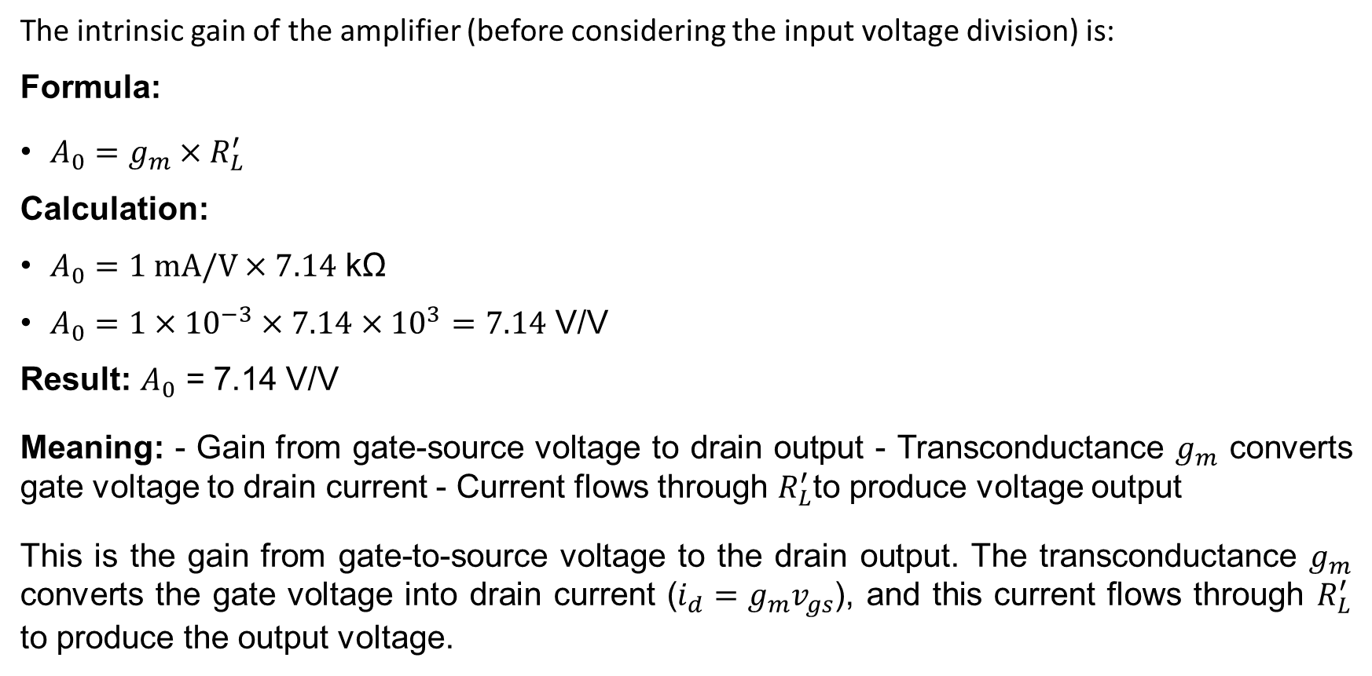
STEP 3: Calculate Intrinsic Voltage Gain
The intrinsic gain of the amplifier (before considering the input voltage division) is:
Formula:
$A_{0}=g_{m}×R_{L}^{′}$
Calculation:
$A_{0}=1 mA/V×7.14$ kΩ
$A_{0}=1×{10}^{−3}×7.14×{10}^{3}=7.14$ V/V
Result: $A_{0}$ = 7.14 V/V
Meaning: - Gain from gate-source voltage to drain output - Transconductance $g_{m}$ converts gate voltage to drain current - Current flows through $R_{L}^{′}$to produce voltage output
This is the gain from gate-to-source voltage to the drain output. The transconductance $g_{m}$ converts the gate voltage into drain current ($i_{d}=g_{m}v_{gs}$), and this current flows through $R_{L}^{′}$ to produce the output voltage.

Slide 7
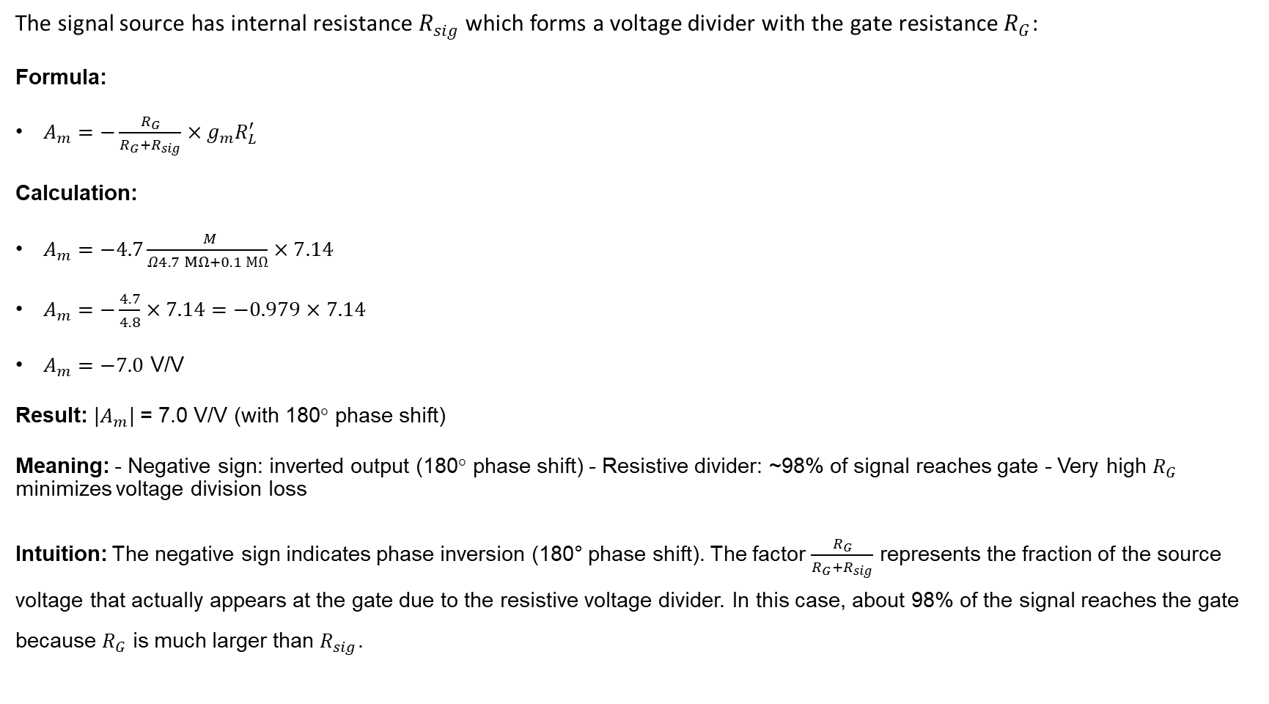
STEP 4: Account for Input Voltage Divider (Midband Gain)
The signal source has internal resistance $R_{sig}$ which forms a voltage divider with the gate resistance $R_{G}$:
Formula:
$A_{m}=−\frac{R_{G}}{R_{G}+R_{sig}}×g_{m}R_{L}^{′}$
Calculation:
$A_{m}=−4.7\frac{ M}{Ω4.7 MΩ+0.1 MΩ}×7.14$
$A_{m}=−\frac{4.7}{4.8}×7.14=−0.979×7.14$
$A_{m}=−7.0$ V/V
Result: |$A_{m}$| = 7.0 V/V (with 180° phase shift)
Meaning: - Negative sign: inverted output (180° phase shift) - Resistive divider: ~98% of signal reaches gate - Very high $R_{G}$ minimizes voltage division loss
Intuition: The negative sign indicates phase inversion (180° phase shift). The factor $\frac{R_{G}}{R_{G}+R_{sig}}$ represents the fraction of the source voltage that actually appears at the gate due to the resistive voltage divider. In this case, about 98% of the signal reaches the gate because $R_{G}$ is much larger than $R_{sig}$.

Slide 8
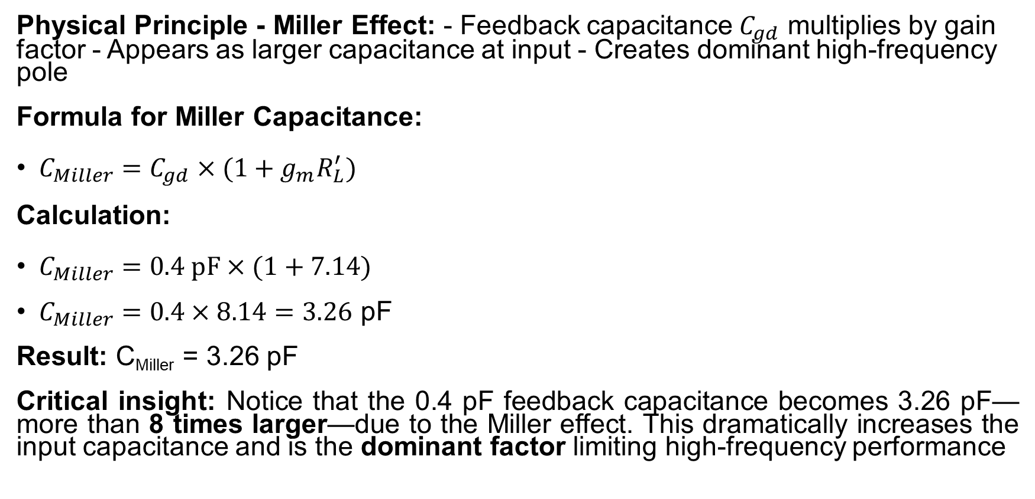
STEP 5: Apply Miller Effect to Calculate Equivalent Input Capacitance
Physical Principle - Miller Effect: - Feedback capacitance $C_{gd}$ multiplies by gain factor - Appears as larger capacitance at input - Creates dominant high-frequency pole
Formula for Miller Capacitance:
$C_{Miller}=C_{gd}×(1+g_{m}R_{L}^{′})$
Calculation:
$C_{Miller}=0.4 pF×(1+7.14)$
$C_{Miller}=0.4×8.14=3.26$ pF
Result: C_{Miller} = 3.26 pF
Critical insight: Notice that the 0.4 pF feedback capacitance becomes 3.26 pF—more than 8 times larger—due to the Miller effect. This dramatically increases the input capacitance and is the dominant factor limiting high-frequency performance

Slide 9
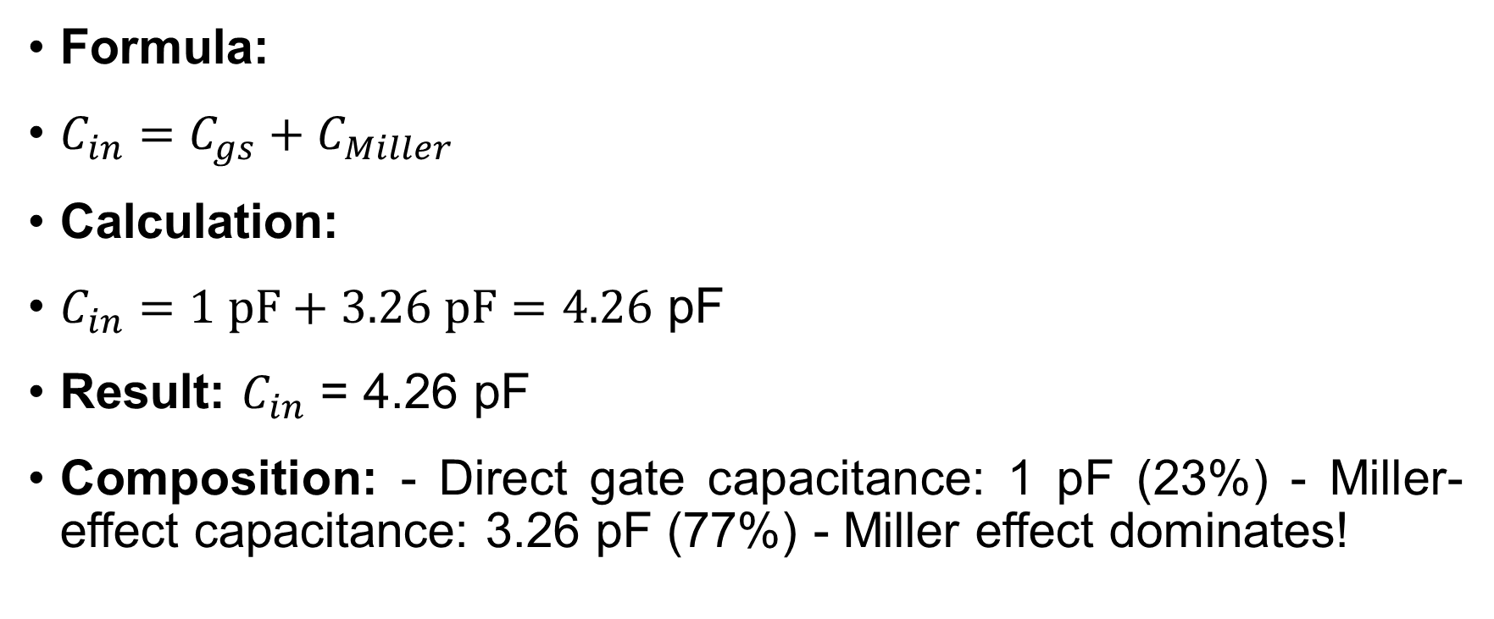
STEP 6: Calculate Total Input Capacitance
Formula:
$C_{in}=C_{gs}+C_{Miller}$
Calculation:
$C_{in}=1 pF+3.26 pF=4.26$ pF
Result: $C_{in}$ = 4.26 pF
Composition: - Direct gate capacitance: 1 pF (23%) - Miller-effect capacitance: 3.26 pF (77%) - Miller effect dominates!

Slide 10
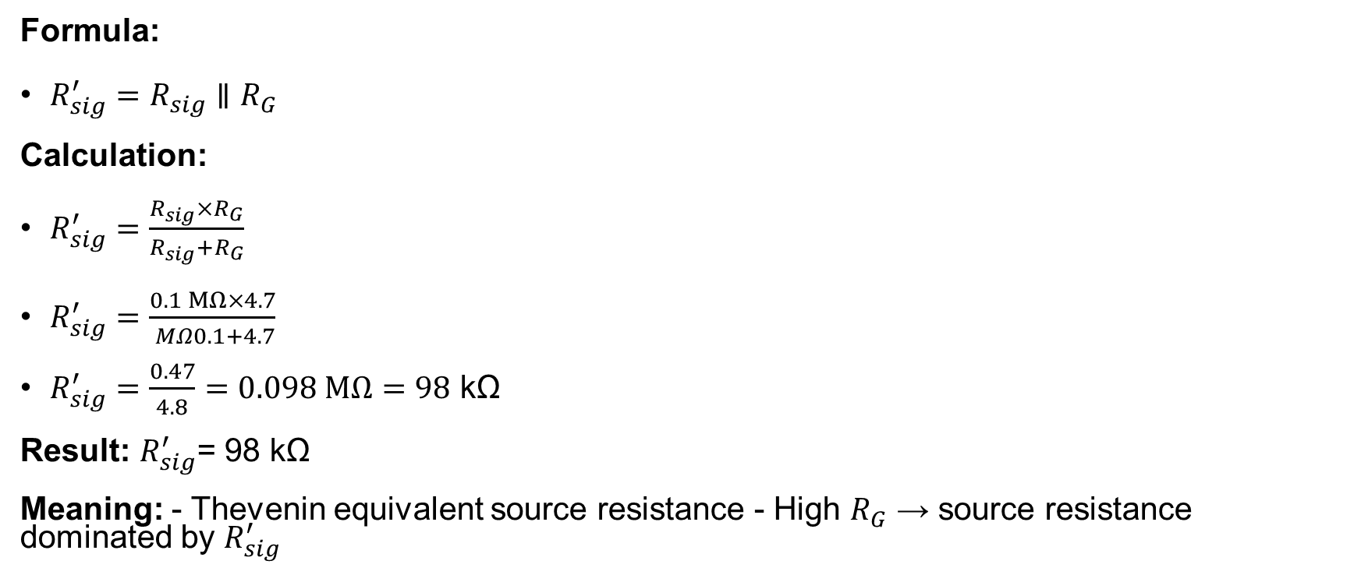
STEP 7: Calculate Effective Source Resistance
Formula:
$R_{sig}^{′}=R_{sig}∥R_{G}$
Calculation:
$R_{sig}^{′}=\frac{R_{sig}×R_{G}}{R_{sig}+R_{G}}$
$R_{sig}^{′}=\frac{0.1 MΩ×4.7}{ MΩ0.1+4.7}$
$R_{sig}^{′}=\frac{0.47}{4.8}=0.098 MΩ=98$ kΩ
Result: $R_{sig}^{′}$= 98 kΩ
Meaning: - Thevenin equivalent source resistance - High $R_{G}$ → source resistance dominated by $R_{sig}^{′}$

Slide 11
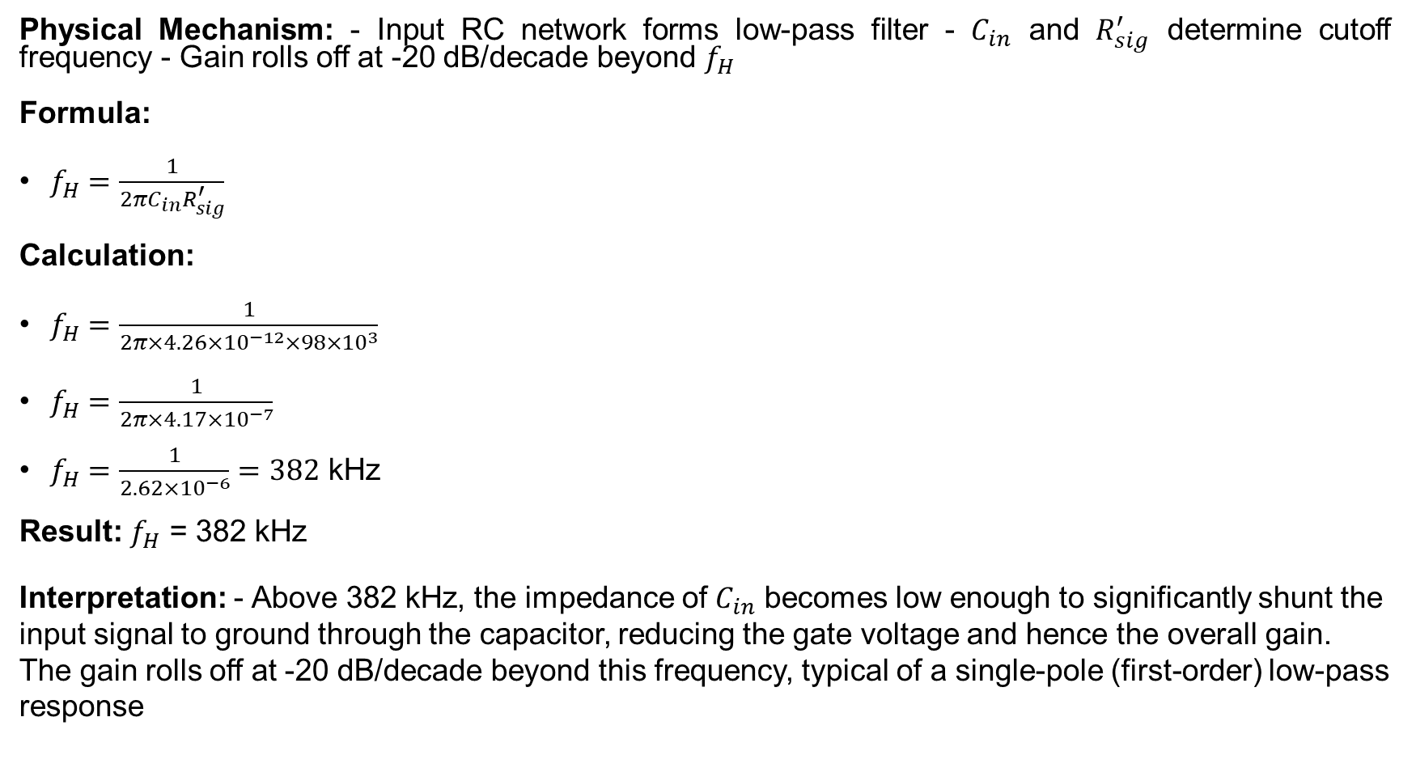
STEP 8: Calculate Upper 3-dB Frequency (High-Frequency Pole)
Physical Mechanism: - Input RC network forms low-pass filter - $C_{in}$ and $R_{sig}^{′}$ determine cutoff frequency - Gain rolls off at -20 dB/decade beyond $f_{H}$
Formula:
$f_{H}=\frac{1}{2πC_{in}R_{sig}^{′}}$
Calculation:
$f_{H}=\frac{1}{2π×4.26×{10}^{−12}×98×{10}^{3}}$
$f_{H}=\frac{1}{2π×4.17×{10}^{−7}}$
$f_{H}=\frac{1}{2.62×{10}^{−6}}=382$ kHz
Result: $f_{H}$ = 382 kHz
Interpretation: - Above 382 kHz, the impedance of $C_{in}$ becomes low enough to significantly shunt the input signal to ground through the capacitor, reducing the gate voltage and hence the overall gain. The gain rolls off at -20 dB/decade beyond this frequency, typical of a single-pole (first-order) low-pass response

Slide 12
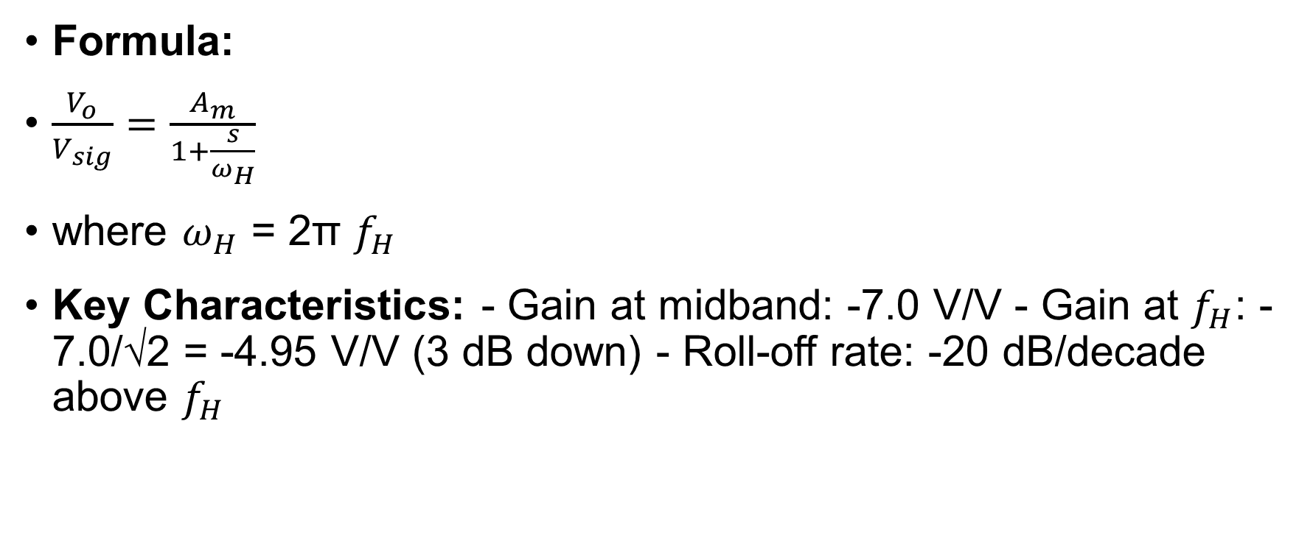
STEP 9: Complete Frequency Response Expression
Formula:
$\frac{V_{o}}{V_{sig}}=\frac{A_{m}}{1+\frac{s}{ω_{H}}}$
where $ω_{H}$ = 2π $f_{H}$
Key Characteristics: - Gain at midband: -7.0 V/V - Gain at $f_{H}$: -7.0/√2 = -4.95 V/V (3 dB down) - Roll-off rate: -20 dB/decade above $f_{H}$

Slide 13
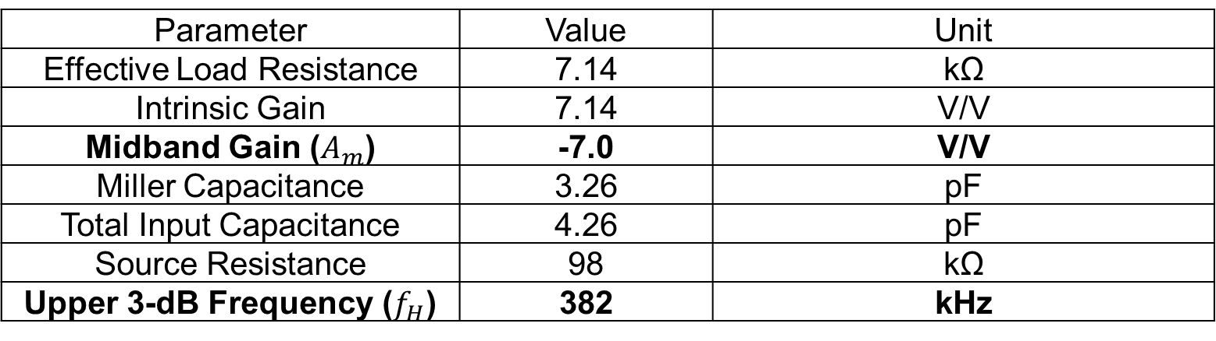
Summary
Parameter | Value | Unit
Effective Load Resistance | 7.14 | kΩ
Intrinsic Gain | 7.14 | V/V
Midband Gain ($A_{m}$) | -7.0 | V/V
Miller Capacitance | 3.26 | pF
Total Input Capacitance | 4.26 | pF
Source Resistance | 98 | kΩ
Upper 3-dB Frequency ($f_{H}$) | 382 | kHz
Key Insights: 1. Miller effect multiplies feedback capacitance by gain factor 2. Input RC time constant dominates high-frequency response 3. Trade-off: higher gain → larger Miller effect → lower bandwidth 4. Reducing source resistance improves bandwidth

Slide 14
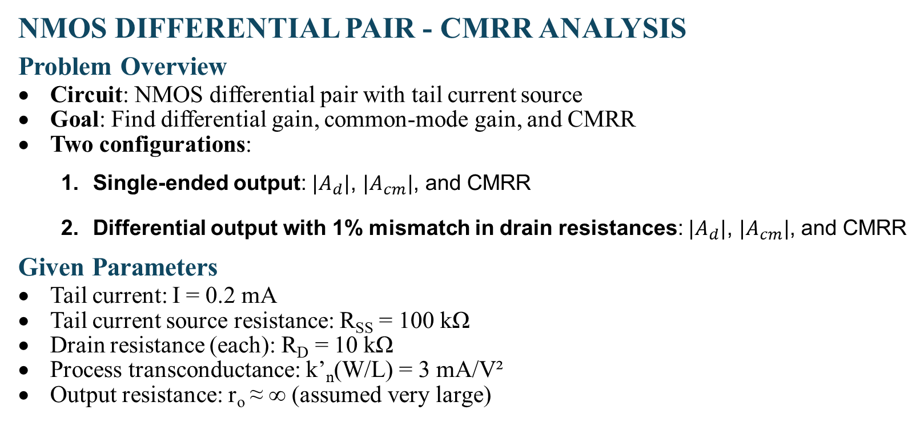
Problem 2
NMOS DIFFERENTIAL PAIR - CMRR ANALYSIS
Problem Overview
Circuit: NMOS differential pair with tail current source
Goal: Find differential gain, common-mode gain, and CMRR
Two configurations:
  Single-ended output: $|A_{d}|$, $|A_{cm}|$, and CMRR
  Differential output with 1% mismatch in drain resistances: $|A_{d}|$, $|A_{cm}|$, and CMRR
Given Parameters
Tail current: I = 0.2 mA
Tail current source resistance: R_{SS} = 100 kΩ
Drain resistance (each): R_{D} = 10 kΩ
Process transconductance: k’_{n}(W/L) = 3 mA/V²
Output resistance: r_{o} ≈ ∞ (assumed very large)

Slide 15
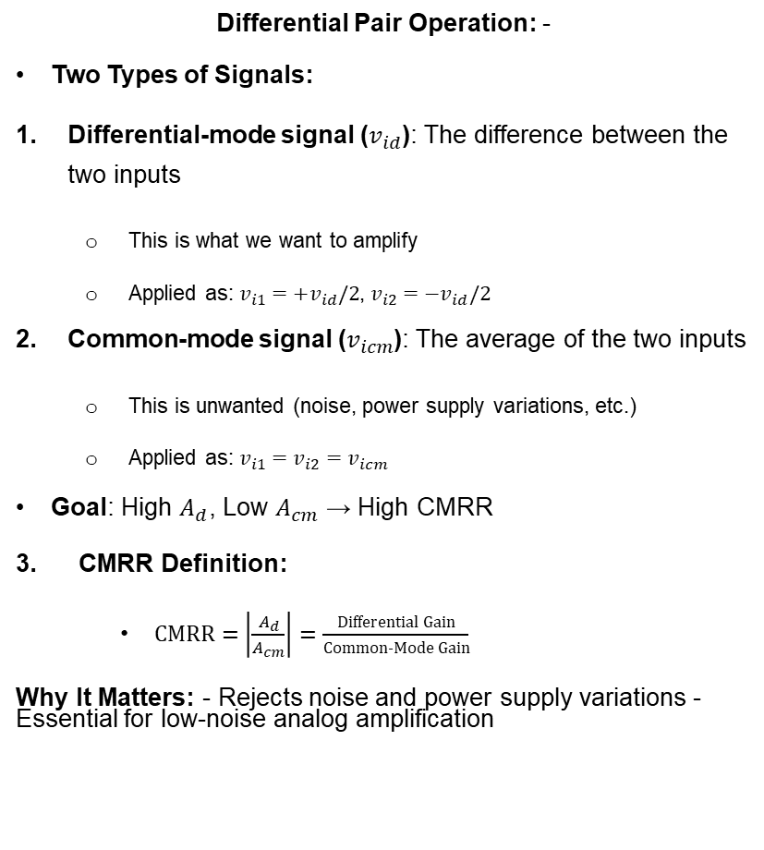
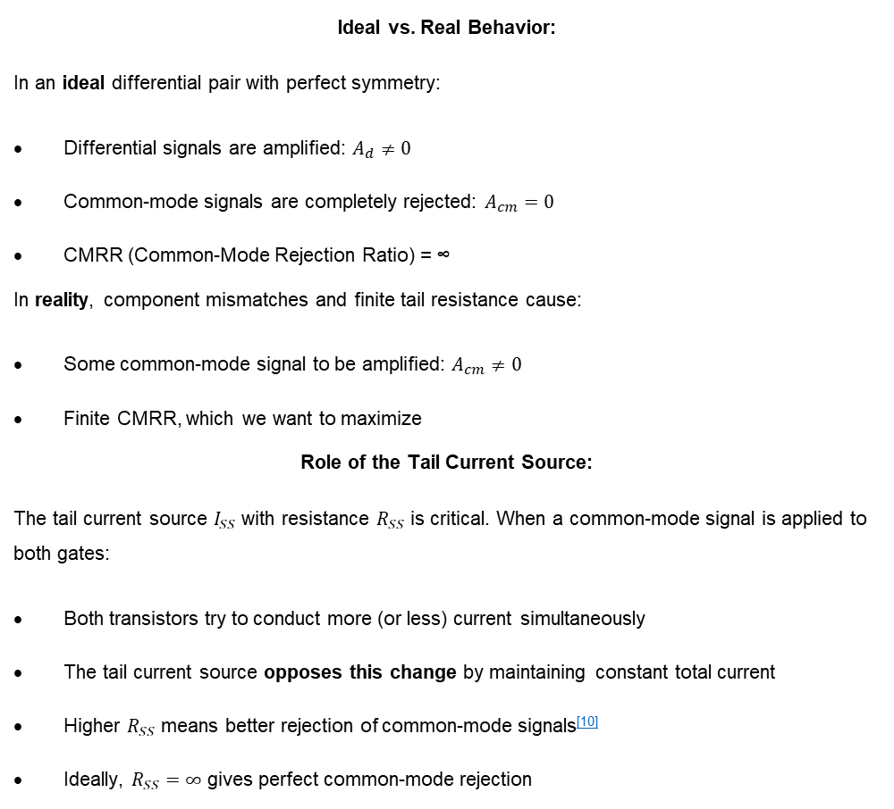
FUNDAMENTAL CONCEPTS
Ideal vs. Real Behavior:
In an ideal differential pair with perfect symmetry:
Differential signals are amplified: $A_{d}≠0$
Common-mode signals are completely rejected: $A_{cm}=0$
CMRR (Common-Mode Rejection Ratio) = ∞
In reality, component mismatches and finite tail resistance cause:
Some common-mode signal to be amplified: $A_{cm}≠0$
Finite CMRR, which we want to maximize
Role of the Tail Current Source:
The tail current source $I_{SS}$ with resistance $R_{SS}$ is critical. When a common-mode signal is applied to both gates:
Both transistors try to conduct more (or less) current simultaneously
The tail current source opposes this change by maintaining constant total current
Higher $R_{SS}$ means better rejection of common-mode signals^{[10]}
Ideally, $R_{SS}=∞$ gives perfect common-mode rejection
Differential Pair Operation: -
Two Types of Signals:
Differential-mode signal ($v_{id}$): The difference between the two inputs
  This is what we want to amplify
  Applied as: $v_{i1}=+v_{id}/2$, $v_{i2}=−v_{id}/2$
Common-mode signal ($v_{icm}$): The average of the two inputs
  This is unwanted (noise, power supply variations, etc.)
  Applied as: $v_{i1}=v_{i2}=v_{icm}$
Goal: High $A_{d}$, Low $A_{cm}$ → High CMRR
3. CMRR Definition:
    $CMRR=\left|\frac{A_{d}}{A_{cm}}\right|=\frac{Differential Gain}{Common-Mode Gain}$
Why It Matters: - Rejects noise and power supply variations - Essential for low-noise analog amplification

Slide 16
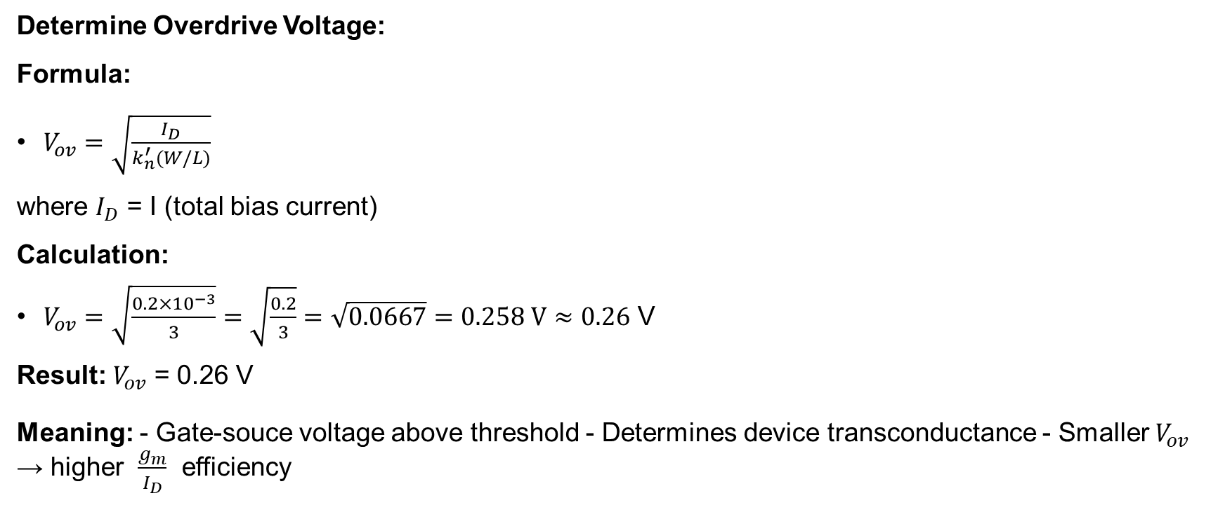
STEP 1: Calculate Device Operating Point
Determine Overdrive Voltage:
Formula:
$V_{ov}=\sqrt{\frac{I_{D}}{k_{n}^{′}(W/L)}}$
where $I_{D}$ = I (total bias current)
Calculation:
$V_{ov}=\sqrt{\frac{0.2×{10}^{−3}}{3}}=\sqrt{\frac{0.2}{3}}=\sqrt{0.0667}=0.258 V≈0.26$ V
Result: $V_{ov}$ = 0.26 V
Meaning: - Gate-souce voltage above threshold - Determines device transconductance - Smaller $V_{ov}$ → higher $\frac{g_{m}}{I_{D}}$ efficiency

Slide 17
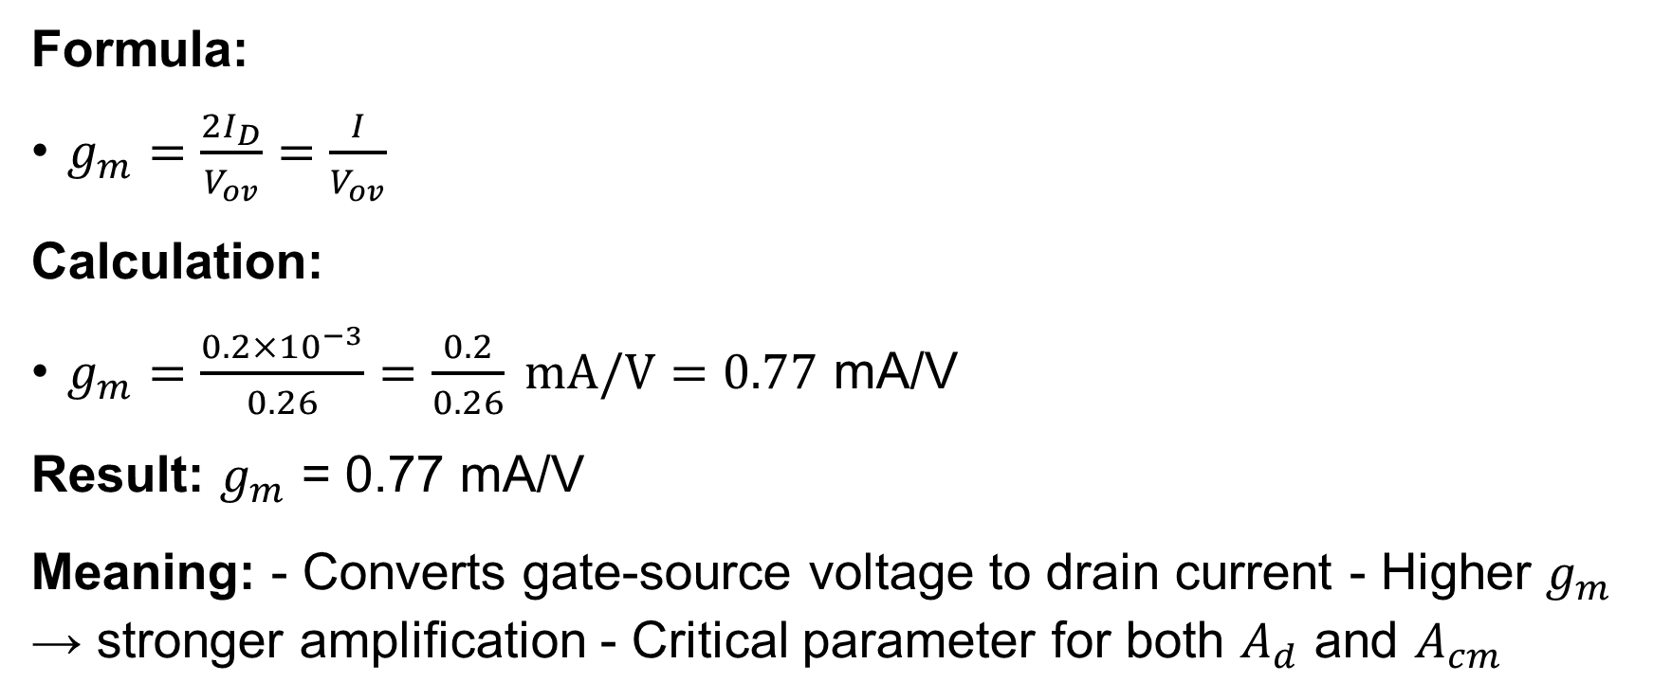
STEP 2: Calculate Transconductance
Formula:
$g_{m}=\frac{2I_{D}}{V_{ov}}=\frac{I}{V_{ov}}$
Calculation:
$g_{m}=\frac{0.2×{10}^{−3}}{0.26}=\frac{0.2}{0.26} mA/V=0.77$ mA/V
Result: $g_{m}$ = 0.77 mA/V
Meaning: - Converts gate-source voltage to drain current - Higher $g_{m}$ → stronger amplification - Critical parameter for both $A_{d}$ and $A_{cm}$

Slide 18
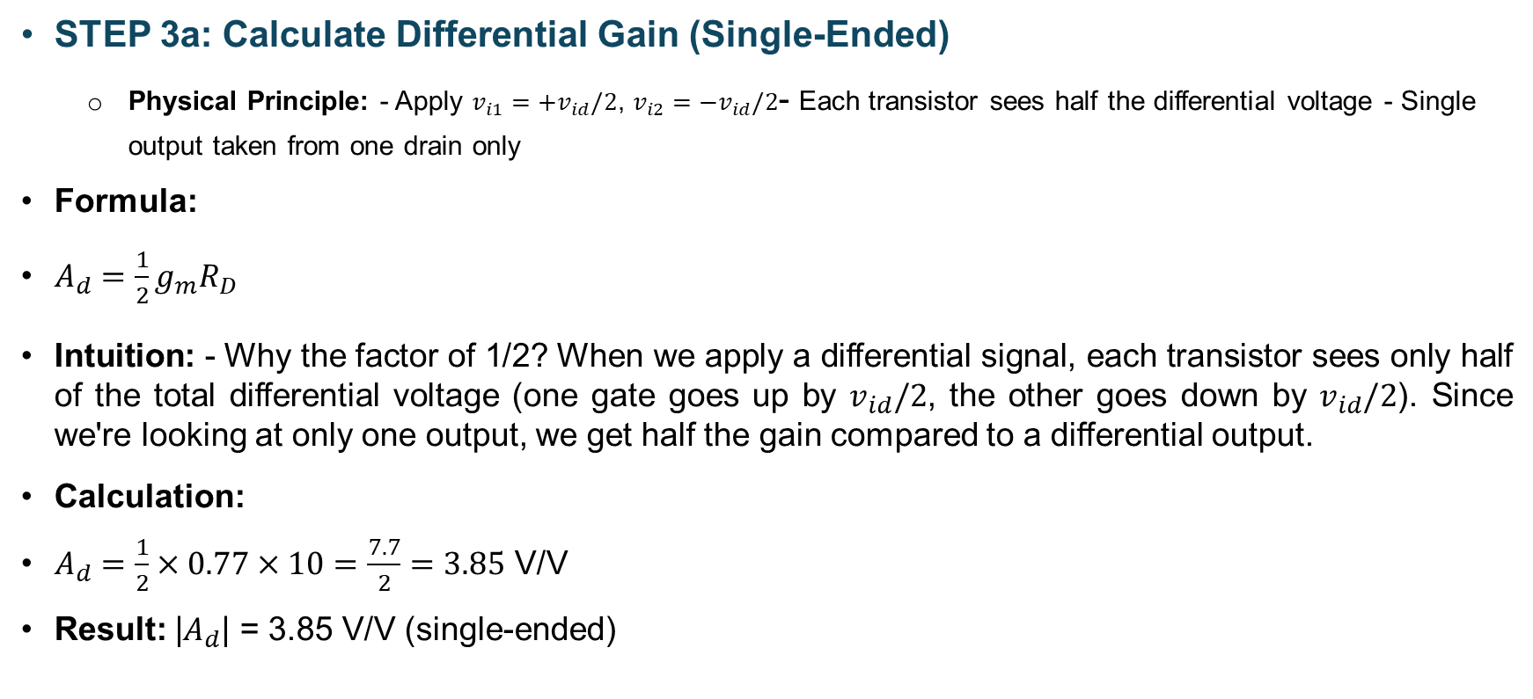
PART (i): SINGLE-ENDED OUTPUT
STEP 3a: Calculate Differential Gain (Single-Ended)
  Physical Principle: - Apply $v_{i1}=+v_{id}/2$, $v_{i2}=−v_{id}/2$- Each transistor sees half the differential voltage - Single output taken from one drain only
Formula:
$A_{d}=\frac{1}{2}g_{m}R_{D}$
Intuition: - Why the factor of 1/2? When we apply a differential signal, each transistor sees only half of the total differential voltage (one gate goes up by $v_{id}/2$, the other goes down by $v_{id}/2$). Since we're looking at only one output, we get half the gain compared to a differential output.
Calculation:
$A_{d}=\frac{1}{2}×0.77×10=\frac{7.7}{2}=3.85$ V/V
Result: |$A_{d}$| = 3.85 V/V (single-ended)

Slide 19
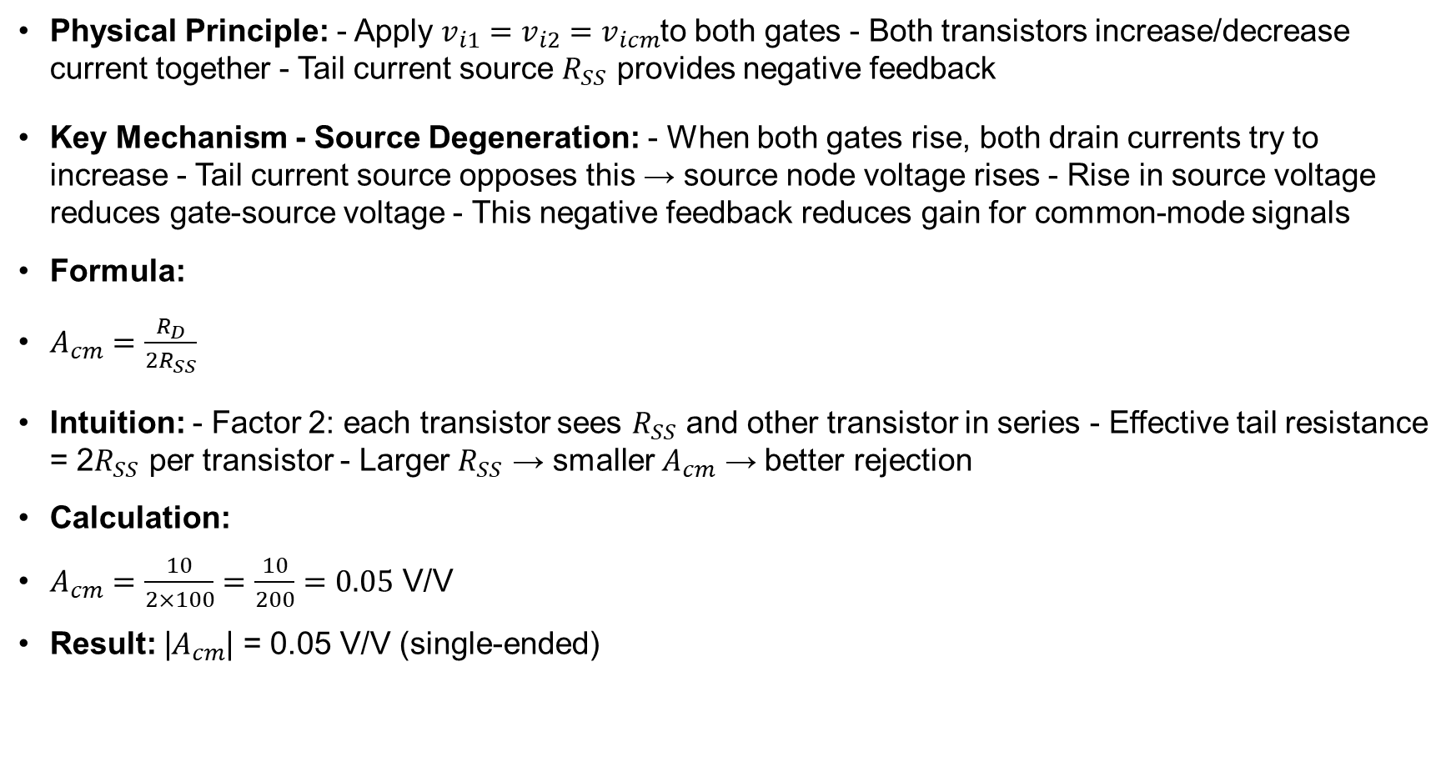
STEP 4a: Calculate Common-Mode Gain (Single-Ended)
Physical Principle: - Apply $v_{i1}=v_{i2}=v_{icm}$to both gates - Both transistors increase/decrease current together - Tail current source $R_{SS}$ provides negative feedback
Key Mechanism - Source Degeneration: - When both gates rise, both drain currents try to increase - Tail current source opposes this → source node voltage rises - Rise in source voltage reduces gate-source voltage - This negative feedback reduces gain for common-mode signals
Formula:
$A_{cm}=\frac{R_{D}}{2R_{SS}}$
Intuition: - Factor 2: each transistor sees $R_{SS}$ and other transistor in series - Effective tail resistance = 2$R_{SS}$ per transistor - Larger $R_{SS}$ → smaller $A_{cm}$ → better rejection
Calculation:
$A_{cm}=\frac{10}{2×100}=\frac{10}{200}=0.05$ V/V
Result: |$A_{cm}$| = 0.05 V/V (single-ended)

Slide 20
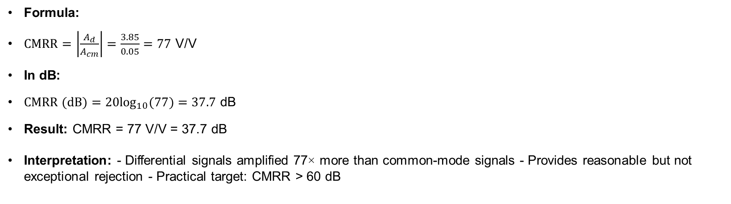
STEP 5a: Calculate CMRR (Single-Ended Output)
Formula:
$CMRR=\left|\frac{A_{d}}{A_{cm}}\right|=\frac{3.85}{0.05}=77$ V/V
In dB:
$CMRR (dB)=20\log_{10}(77)=37.7$ dB
Result: CMRR = 77 V/V = 37.7 dB
Interpretation: - Differential signals amplified 77× more than common-mode signals - Provides reasonable but not exceptional rejection - Practical target: CMRR > 60 dB
Parameter | Value | Unit
Differential Gain | 3.85 | V/V
Common-Mode Gain | 0.05 | V/V
CMRR (Linear) | 77 | V/V
CMRR (dB) | 37.7 | dB
Key Point: - Single-ended output provides moderate CMRR - Limited by finite tail resistance $R_{SS}$

Slide 21
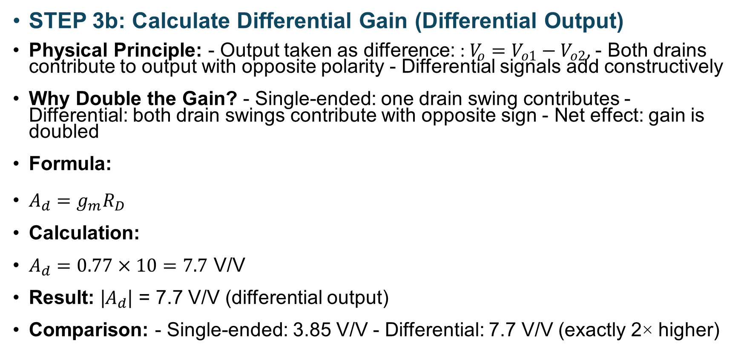
PART (ii): DIFFERENTIAL OUTPUT WITH 1% MISMATCH
STEP 3b: Calculate Differential Gain (Differential Output)
Physical Principle: - Output taken as difference: : $V_{o}=V_{o1}−V_{o2}$, - Both drains contribute to output with opposite polarity - Differential signals add constructively
Why Double the Gain? - Single-ended: one drain swing contributes - Differential: both drain swings contribute with opposite sign - Net effect: gain is doubled
Formula:
$A_{d}=g_{m}R_{D}$
Calculation:
$A_{d}=0.77×10=7.7$ V/V
Result: |$A_{d}$| = 7.7 V/V (differential output)
Comparison: - Single-ended: 3.85 V/V - Differential: 7.7 V/V (exactly 2× higher)

Slide 22
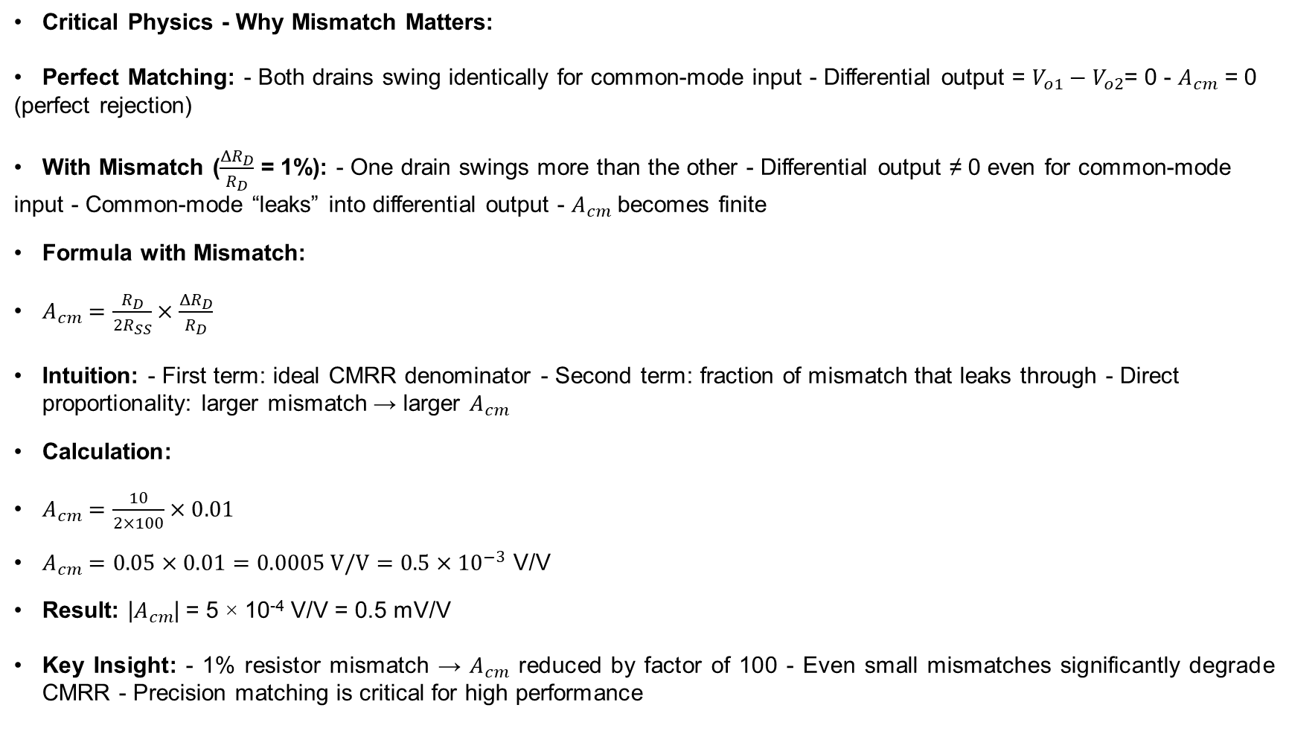
STEP 4b: Calculate Common-Mode Gain (With 1% Mismatch)
Critical Physics - Why Mismatch Matters:
Perfect Matching: - Both drains swing identically for common-mode input - Differential output = $V_{o1}−V_{o2}$= 0 - $A_{cm}$ = 0 (perfect rejection)
With Mismatch ($\frac{ΔR_{D}}{R_{D}}$ = 1%): - One drain swings more than the other - Differential output ≠ 0 even for common-mode input - Common-mode “leaks” into differential output - $A_{cm}$ becomes finite
Formula with Mismatch:
$A_{cm}=\frac{R_{D}}{2R_{SS}}×\frac{ΔR_{D}}{R_{D}}$
Intuition: - First term: ideal CMRR denominator - Second term: fraction of mismatch that leaks through - Direct proportionality: larger mismatch → larger $A_{cm}$
Calculation:
$A_{cm}=\frac{10}{2×100}×0.01$
$A_{cm}=0.05×0.01=0.0005 V/V=0.5×{10}^{−3}$ V/V
Result: |$A_{cm}$| = 5 × 10⁻⁴ V/V = 0.5 mV/V
Key Insight: - 1% resistor mismatch → $A_{cm}$ reduced by factor of 100 - Even small mismatches significantly degrade CMRR - Precision matching is critical for high performance

Slide 23
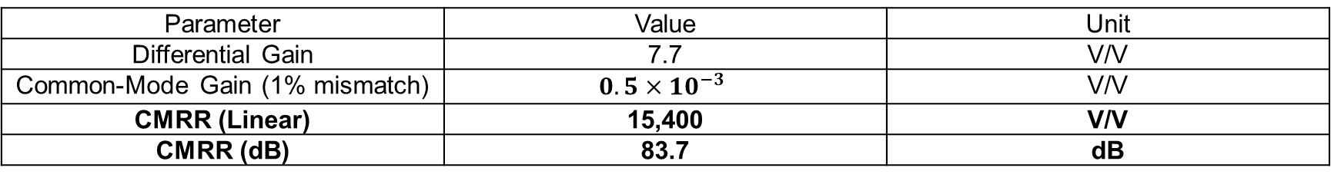
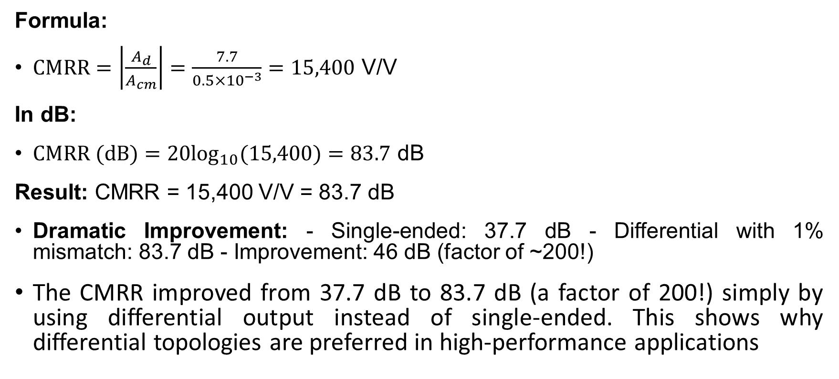
STEP 5b: Calculate CMRR (Differential Output with Mismatch)
Formula:
$CMRR=\left|\frac{A_{d}}{A_{cm}}\right|=\frac{7.7}{0.5×{10}^{−3}}=15,400$ V/V
In dB:
$CMRR (dB)=20\log_{10}(15,400)=83.7$ dB
Result: CMRR = 15,400 V/V = 83.7 dB
Dramatic Improvement: - Single-ended: 37.7 dB - Differential with 1% mismatch: 83.7 dB - Improvement: 46 dB (factor of ~200!)
The CMRR improved from 37.7 dB to 83.7 dB (a factor of 200!) simply by using differential output instead of single-ended. This shows why differential topologies are preferred in high-performance applications
Parameter | Value | Unit
Differential Gain | 7.7 | V/V
Common-Mode Gain (1% mismatch) | $$0.5×{10}^{−3}$$ | V/V
CMRR (Linear) | 15,400 | V/V
CMRR (dB) | 83.7 | dB

Slide 24
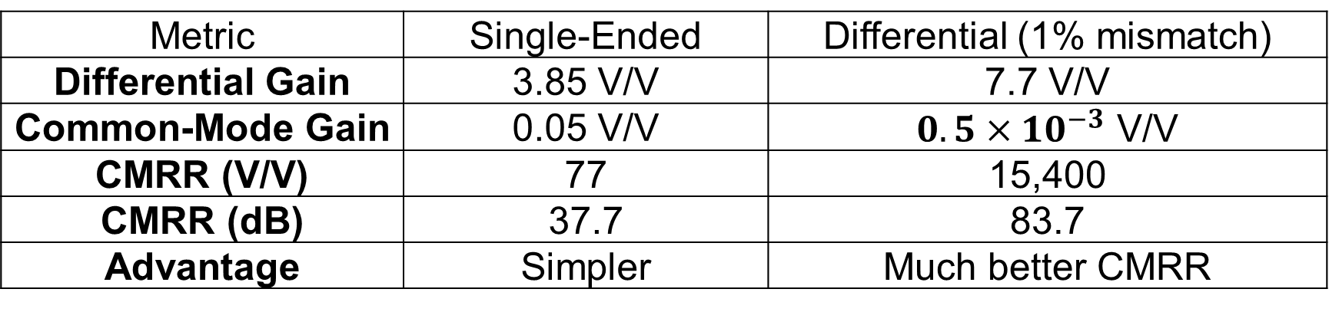
Summary
Metric | Single-Ended | Differential (1% mismatch)
Differential Gain | 3.85 V/V | 7.7 V/V
Common-Mode Gain | 0.05 V/V | $0.5×{10}^{−3}$ V/V
CMRR (V/V) | 77 | 15,400
CMRR (dB) | 37.7 | 83.7
Advantage | Simpler | Much better CMRR

